Slide 1
Organization of Computers
Chapter#2

Slide 2
Computer Organization

Slide 3
Computer Organization
Computer Organization refers to the operational units and there interconnections
Examples of organizational attributes includes Hardware details transparent to the programmer
Such as control signals,
Interface between computers and peripherals,
Memory technology used, which accepts digital or binary data as input.

Slide 4
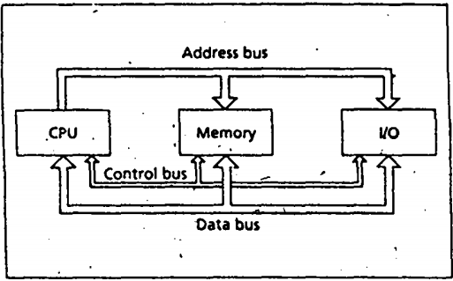
Computer Organization

Slide 5
Computer Architecture

Slide 6
Computer Architecture
Computer Architecture refers to those attributes of a system visible to a programmer
Those attributes that have direct impact on the logical execution of the program.
Examples of the Architectural attributes include the instruction set,
The no of bits used to represent the data types,
Input Output mechanism and technique for addressing memories.

Slide 7
Microprocessor

Slide 8
Microprocessor
A microprocessor is a computer processor which incorporates the functions of a computer's central processing unit (CPU) on a single integrated circuit (IC), or at most a few integrated circuits.
The microprocessor is a multipurpose, clock , driven , register based programmable electronic device,
Which accepts digital or binary data as input,
Processes it according to instructions stored in its memory,
Provides results as output
Contains no RAM, no ROM, no I/O ports on the chip itself

Slide 9
Microcontroller

Slide 10
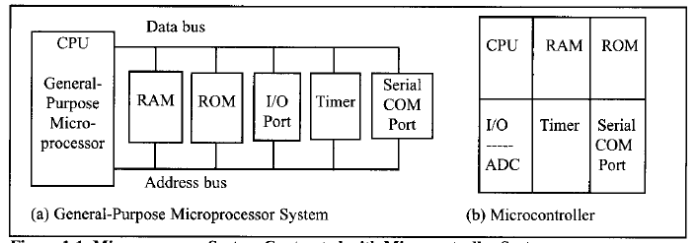
Microcontroller
A Microcontroller has a CPU ( microprocessor) in addition to a fixed to a fixed amount of RAM, ROM, I/O ports and a timer all on a single chip.

Slide 11
Memory & Address

Slide 12
Memory
Information processed by the computer is stored in its memory.
A memory circuit element can store one bit of data.
A group of eight bits of data is called a byte.
Each byte is identified by a number called address of that byte.
The first memory byte has address 0.
The data stored in a memory byte are called its contents.
Crumb = 2 bits
Nibble = 4 bits
Byte = 8 bits
Word = 16 bits
Double Word=32 bits

Slide 13
Address & Content
Contents of memory byte are always eight bits.
The number of bits in an address depends on the processor.
For example, the intel 8086 microprocessor uses a 20-bit address.
The intel 80286 micro processor uses a 24-bit address.
The number of bits used in the address determines the number of bytes that can be accessed by the processor.
Address | Accessible memory locations
1 bit | 2 | 0,1
2 bits | 4 | 00,01,10,11
3 bits | 8 | 000,001,010,011,100,101,110,111

Slide 14
Word & Memory Word

Slide 15
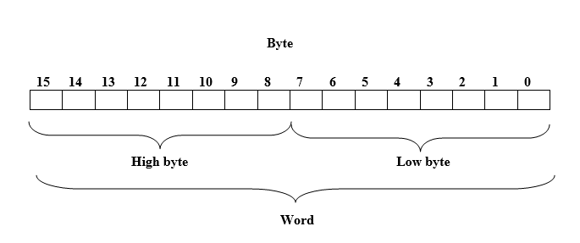
Word & Memory Word
Two bytes form a word.
IBM PC allows any pair of successive memory bytes to be treated as a single unit, called memory word.
The lower address of the two memory bytes is used as the address of the memory word.

Slide 16
Memory Operations

Slide 17
Memory Operations
Microprocessor perform two operations on memory
Read (fetch) the contents of a location and
Write (store) data at a location.
In a read operation, a microprocessor gets a copy of the data and the original contents of the memory location are unchanged.
In a write operation, the data written becomes the new contents of the location and the original contents are lost.
There are two kinds of memory circuits
Random access memory (RAM)
  RAM locations can be read and written
  Program instructions and data are normally loaded into RAM memory.
Read only memory (ROM)
  The contents of ROM cannot be changed, once initialized.
  ROM circuits retain their values even when the power is off.
  ROM is used by computer manufacturers to store system programs.

Slide 18
Bus

Slide 19
Buses

Slide 20
Buses
Buses are set of wires that connect the different components of a computer.
A processor communicates with memory and I/O circuits using signal that travel through buses.
There are three kinds of signal: address, data and control.
Corresponding to these signals there are three buses: address bus, data bus and control bus.
To read contents of a memory location, the CPU places the address of the memory location on the address bus.
A control signal is generated to inform the memory location to perform the requested operation. The CPU sends this control signal on the control bus.
The memory circuit sends the requested data to the CPU using data bus.

Slide 21
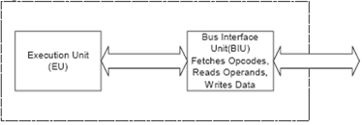
CPU Organization

Slide 22
EU & BIU
The 8086 CPU logic has been partitioned into two functional units namely Bus Interface Unit (BIU) and Execution Unit (EU)
The major reason for this separation is to increase the processing speed of the processor
The BIU has to interact with memory and input and output devices in fetching the instructions and data required by the EU
EU is responsible for executing the instructions of the programs and to carry out the required processing

Slide 23
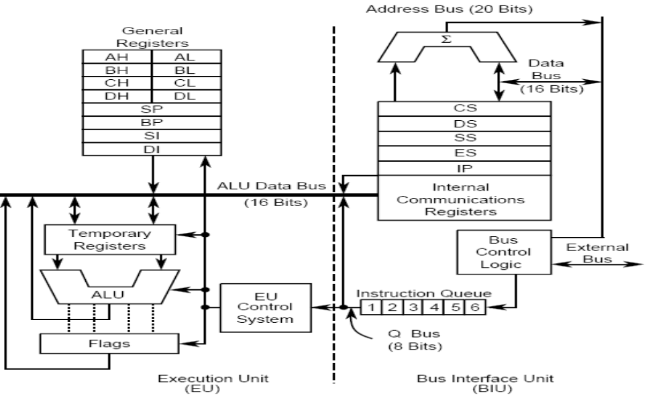
Architecture Diagram

Slide 24
Execution Unit
The purpose of the execution unit (EU) is to
execute Instructions.
Control unit is responsible for the co-ordination of all other units of the processor
It contains a circuit called the arithmetic and logic unit (ALU).
The ALU can perform arithmetic (+, - , x ,I) and logic (AND,OR, NOT} operations.

Slide 25
Execution Unit
The data for the operations are stored in circuits called
Register.
A register is a memory location referred by a name rather than a number.
The registers are classified according to the functions they perform.
In general
  data registers hold data for an operation,
  address registers hold the address of instruction or data
  and flag registers keeps the current state of the processor.

Slide 26
BIU
The bus Interface unit (BIU) facilitates the communication between the EU and the memory
or I/O circuits.
It is responsible for transmitting addresses, data and control signals on the buses.
Its registers (CS,OS, ES, SS, IP) hold addresses of memory locations.
The IP(Instruction pointer) contains the address of the next instruction to be executed by the EU.
The EU and the BIU are connected by an internal bus and they work together.

Slide 27
I/O Ports
I/O devices are connected to the computer through I/O circuits.
I/O circuits contains several registers called I/O ports.
I/O ports are used for data and control commands.
I/O ports have addresses known as I/O addresses
I/O ports are connected to the bus system and can only
be used in input or output instructions.
I/O ports function as transfer points between the CPU and I/O devices.
Data to be Input from an I/O devise are sent to a port where they can be read by the CPU.
On output, the CPU writes data to an I/O port. The I/O
circuit then transmits the data to the I/O device.

Slide 28
Serial & Parallel Ports
A port that transfer 1 bit at a time between an I/O port and an I/O device is serial port.
Slow devices like the keyboard, always connect to a serial port.
A port that transfer 8 or 16 bit at a time between an I/O port and an I/O device is parallel port.
A parallel port requires more wiring connections.
Fast devices, like the disk drive, always connect to a parallel port.
Some devices, like the printer, can connect to either a serial or a parallel port.

Slide 29
Instruction Execution
A machine instruction has two parts: an opcode and
operands.
The opcode specifies the type of operation
The operands are often memory addresses to the data to be operated on.
The CPU goes through the following steps to execute a machine instruction (the fetch-execute cycle).
Fetch
1. Fetch an instruction from memory.
2. Decode the Instruction to determine the operation.
3. Fetch data from memory if necessary.
Execute
4. Perform the operation on the data.
5. Store the result in memory if needed.

Slide 30
Instruction Execution Example
The instruction that adds the contents of register AX to the contents of the memory word a address 0.
The CPU actually adds the two numbers in the ALU and then stores the result back to memory word 0.
The machine code is
00000001 00000110 00000000 00000000

Slide 31
Fetch the instruction.
To start the cycle, the BIU places a memory read request on the control bus and the address of the instruction on the address bus.
Memory responds by sending the contents of the location specified-namely, the instruction code just given-over the data bus,
Because the instruction code is four bytes and the 8086 can only read a word at a time, this involves two read operations.
The CPU accepts the data and adds four to the IP so that the IP will contain the address of the next instruction.

Slide 32
Decode the instruction & Fetch data from memory
On receiving the instruction, a decoder circuit in the EU decodes the instruction and determines that it is an ADD operation involving the word at address 0.
The EU informs the BIU to get the contents of memory word 0.
The BIU sends address 0 over the address bus and a memory read request is again sent over the control bus.
The contents of memory word 0 are sent back over
the data bus to the EU and are placed in a holding register.

Slide 33
Perform the operation &
Store the result
The contents of the holding register and the AX register are sent to the ALU circuit, which performs the required addition and holds the sum.
The EU directs the BIU to store the sum at address 0.
BIU sends out a memory write request over the control bus, the address 0 over the address bus, and the sum
10 be stored over the data bus.
The previous contents of memory word 0are overwritten by the sum.

Slide 34
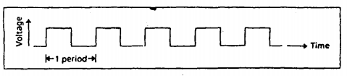
Timing
A clock circuit controls the processor by generating a train of clock pulses.
Time interval between two pulses is known as a clock period.
Number of pulses per second is called the clock rate or clock speed, measured in megahertz(MHz).

Slide 35
Timing
Computer circuits are activated by the clock pulses.
Circuits perform an operation only when a clock pulse
is present.
Each step in the instruction fetch-execution cycle requires one or more clock periods.
8086 takes four clock periods to do a memory read
Multiplication operation may take more than seventy clock periods.
Speed up the clock circuit, a processor can be made
to operate faster.

Slide 36
Architecture Diagram

Slide 37
Intel 8086 family of microprocessors

Slide 38
Year | Microprocessor | Data bus | Address bus | Speed
1978 | 8086 | 16 bit | 20 bit | 10 MHz
1979 | 8088 | 8 bit
 | 80186 | 16 bit | 20 bit
 | 80188 | 8 bit
1982 | 80286 | 16 bit | 24 bit | 12.5 MHz | Real address mode and protected virtual address mode
1985 | 80386 | 32 bit |  | 33 MHz | Real address mode and protected virtual address mode
 | 80386SX | 16 bit |  |  | Real address mode and protected virtual address mode
 | 80387 |  |  |  | Floating point arithmetic
1989 | 80486 | 32 bit |  |  | Floating point arithmetic + Cache memory 8 KB
 | 80486SX | 32 bit |  |  | Cache memory but no Floating point arithmetic

Slide 39
8086 family
Multi-tasking: Ability to execute several programs/tasks at the same time.
Memory protection: The ability to protect the memory used by one program from the actions of another program.
Virtual memory: Treating the external storage i.e. disk as if it were physical memory.
In real address mode 80286 behaves like 8086 and programs for 8086 can be executed without modification.
In protected virtual address mode also called protected mode, the 80286 supports multitasking and memory protection.
The 80286 can address 16 MB of physical memory in protected mode whereas in protected virtual address mode it can treat external storage as if it were physical memory and execute programs up to 1 GB.

Slide 40
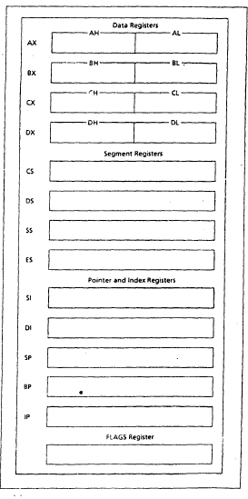
8086 Registers

Slide 41
Data Registers (AX, BX, CX, DX)
Available to the programmer for general data manipulation.
The high and low bytes of the data registers can be accessed separately.
Accumulator Register (AX)
it is preferred register to use for arithmetic, logic and data transfer instructions because its use generates the shortest machine code.
In multiplication and division operations, one of the numbers involved must be in AX or AL.
I/O operations also require the use of AL and AX.

Slide 42
Data Registers (AX, BX, CX, DX)
Base Register (BX)
It can also serves as address register.
Counter Register (CX)
Program loop constructions are facilitated by the use of CX.
CL is used as a count in instructions that shift and rotate the bits.
Data Register (DX)
Multiplication and division.
I/O operations.

Slide 43
Address Registers
A typical Address registers store addresses of instructions and data in memory. These values are used by the processor to access the memory.
A memory is a collection of bytes. Each memory byte has an address starting with 0.
The 8086 processor assigns a 20-bit physical address to its memory locations and it is possible to address 1MB of memory. For example,
00000h
00001h
00002h
00003h.
00009h
0000Ah
………..
FFFFFh

Slide 44
Memory Segments
How typical 20-bit address fits in a 16-bit register?
The 8086 gets around this problem by partitioning its memory into segments.
A memory segment is a block of 64 K (216) consecutive memory bytes.
Each segment is identified by a segment number starting with 0.
A segment number is 16 bits so the highest segment number is FFFFh.
Within a segment, memory location is specified by giving an offset. This is the number of bytes from the beginning of the segment.
For a 64 KB segment, the offset can be given as a 16-bit number. The first byte in a segment has offset 0. The last offset in a segment is FFFFh.

Slide 45
Memory Segments
A memory location may be specified by providing a segment number and an offset having form
segment : offset
This is known as a logical address. For example, A4FB:4872h means offset 4872h within segment A4FBh.
To obtain a 20-bit physical address, the 8086 micro processor first multiplies the segment address by 10 and then adds the offset.
A4FBx10 = A4FB0h + 4872h = A9822h.
[B+7 = 11 + 7 = 18 = 16 + 2 = Carry + 2]
[F + 8 + Carry = 15 + 8 + 1 = 24 = 16 + 8 = Carry + 8]
[4 + 4 + Carry = 4 + 4 + 1 = 9 = 8 + 1 = 9]
[A + 0 = A]

Slide 46
Address registers
A typical machine language program consists of instructions (code) and data.
A data structure called the stack used by the processor to implement procedure calls.
The program's code, data, and stack are loaded into different memory segments (code segment, data segment, and stack segment ).
Address registers can be subdivided into:
  Segment registers
  Pointer registers
  Index registers

Slide 47
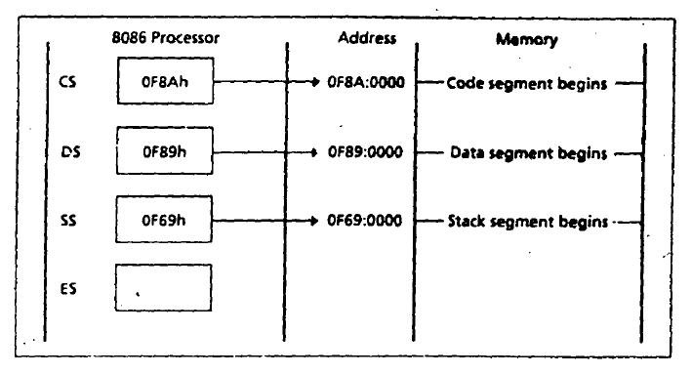
Segment Registers
8086 uses segment registers to keep track of different program segments. Segment registers hold segment numbers.
Code Segment (CS)
  holds the code segment number.
Data Segment (DS)
  holds the data segment number.
Stack Segment (SS)
  holds the stack segment number.
Extra Segment (ES)
  holds the additional segment number

Slide 48
Pointer and Index Registers
These registers normally contain the offset address of memory locations.
Unlike segment registers, these registers can be used in arithmetic and other operations.
Stack Pointer (SP) : It is used in conjunction with SS for accessing the stack segment.
Base Pointer (BP) : It is used to access the data on the segments. Unlike SP it is not restricted to stack segment only.
Source Index (SI) : It is used to point to memory locations in the data segment addressed by DS. By incrementing the contents of SI, consecutive memory locations can be easily accessed.
Destination Index (DI) : It functions similar to SI. For string operations, DI is used to access the memory locations addressed by ES.

Slide 49
Instruction Pointer (IP)
The 8086 uses IP in conjunction with CS to access the instructions.
The CS register contains the segment number of the next instruction and the IP contains the offset.
IP is updated each time an instruction is executed so that it can point to the next instruction.
Unlike other registers IP cannot be manipulated directly by an instruction.
Calculate the number of memory segments constructed by 8086 processor?
Available memory = 1 MB = 2 * 20
Segment Size = 64 K = 2 * 16
Number of available segments = 2 * 20 / 2 * 16= 2 * 4= 16.

Slide 50
Flag Register
It indicates the status of the microprocessor by setting individual bits called flags.
There are two kinds of flags:
  status flags
  control flags.
The status flags reflect the result of an instruction executed by the processor e.g. when a subtraction operation results in a 0, a zero flag (ZF) is set to 1.
The control flags enable or disable certain operations of the microprocessor e.g. if interrupt flag (IF) is set to 0, inputs from the keyboard are ignored by the processor.

Slide 51
Memory Organization Of PC
8086 processor is capable of addressing 1 MB of memory. However, not all the memory can be used by an application program.
Some memory locations have special meaning for the processor. For example, the first kilobyte (00000 to 003FFh) is used for interrupt vectors.
Other memory locations are reserved by IBM for special purposes, such as for BIOS routines and video display memory.
The display memory holds the data that are being displayed on the monitor.

Slide 52
